Slide 1
Sweater Company Launch Spring 2016 kick off
Presenter’s Name:
Khushboo jha

Slide 2
Agenda
Project Objectives & Overview
Project and process scope
Organization Chart
Deliverables & Project Flow
Launch Schedule & Project Risks
Change Management Plan

Slide 3
Project Objectives
Introduce new line of high quality sweaters (3S Sweater Line) in multiple colors and full range of sizes
The sweaters should be on the 12 retail store shelves in nine months from January 1st 2016

Slide 4
Project Overview
Introduce a new line of sweaters (3S Sweater Line) to be on their retail store shelves
Manufacture, assemble, ship and distribute these sweaters to the 12 retail stores in United States
This sweater line will consist of three models; S101 Shawl collar pull over, V102 v neck pull over, and T103 turtle neck pull over
All models will be in multiple colors and full range of sizes

Slide 5
Project Scope
In Scope:
The models will be only of type S101 Shawl collar pull over, V102 v neck pull over, T103 turtle neck pull over
The models will be of size XXL, XL, L, M, S, XS
The colors will be green, blue, pink, yellow
Material will be of wool only-Merino , Alpaca
Sweater designs will be as per the design document
PMG guidelines will be followed

Slide 6
Project Scope Continued…
Out of Scope:
The sweater will be as per
The models as specified
The sizes as mentioned
The colors as mentioned
Material will be only of the mentioned wool type(Merino ,Alpaca)

Slide 7
Process Scope
1. Sales and Marketing Department will take lead in setting strategies, researching customer needs and decides what marketing communications it needs to support its efforts
2. Design Department will meet the highest design requirements of the project and articulate their own unique vision through the clothing they design and make
3. Purchasing Department responsible for purchasing yarn as per color wise consumption from yarn mill/supplier
4. Manufacturing Department responsible for knitting the different parts of the sweater i.e. front part, back part, sleeve etc.
Notes:
3. Purchasing Department: Purchasing Yarn: Purchase yarn as per color wise consumption from yarn mill/supplier. They have to be careful regarding yarn count, approved shade and color wise quantity (including wastage) at the time of purchasing yarn. They have to store the yarn systematically in yarn store.

Slide 8
Process Scope Continued…
5. Assembly and Finishing Department will inspect different knitted parts of the sweater and send to linking section
6. Transportation and Logistic Department will be responsible for in time transportation of the products
7. Regional Warehouse Department is responsible for cartons containing manufactured garments stored at regional warehouse
8. Corporate Distribution Center is responsible for distributing stock to distribution center
Notes:
5. Assembly and Finishing Department will inspect different knitted parts of the sweater and send to linking section . Linking operators link different parts of the garment. QC team will inspect them. Linked sweaters are trimmed and ironed to remove unwanted crease and to improve the smoothness
6. Transportation and Logistic Department will be responsible for in time transportation of the products. If a sweater doesn't get to a store by a certain date, it won't be the hot item anymore

Slide 9
Process Out Of Scope
No change in designs, colors will be incorporated during the production process.
Enhancement will be considered based on the timeframe for the requirement needs.
Pattern knitting is not in scope
What functions, geos, markets, etc. are in scope?

Slide 10
Organization Chart
Steering Committee
PM
Marketing and Sales
Manager
Finance
Manager
Design
Manager
Purchasing Manager
Transport& Logistics Manager
Manufacturing & Assembly Manager
Regional Warehouse
Manager
Marketing Lead
HR Lead
Design Head
Purchasing Lead
Transport& Logistics Lead
Manufactu-ring Lead
Warehouse Manager
Sales Lead
Accounts Lead
Designing staff
Purchasing Staff
Transport& Logistics staff
Assembly Lead
Warehouse staff

Slide 11
Project Flow
Sales and Marketing
Design
Purchasing
Material Supplier
Retail Stores
Mfg. Co.
Assembly & Finishing
Regional Warehouse
Distribution
Center
Trans. & Logistics

Slide 12


Deliverables
Plan Objective
Confirm scope - Communication Plan
Project Charter - Kickoff
Detailed plan - Checklist
Risk Assessment - Stakeholder Analysis
Indicates Go / No-Go Decision Point
PHASE 1
PH. 2
PHASE 3
PHASE 4
Initiation
Feasibility/Analysis
Design
Manufacturing, shipping
Warehousing, Distribution and retailing
Closeout and Audit
Plan
Plan
Objective
Market Research
Establish senior management committee
Appoint PM
nDeliverables
Project Initiation Document
Initial requirement document
Objective
Analyze budget requirement
Procurement
WBS
Deliverables
Project objectives statement
Budget approval
Raw materials
Objective
Finalize sweater designs
Deliverables
Design document
Sign off on designs
Objective
Manufacture
Audit
Assemble sweaters
Ship to warehouse
Deliverables
Sweaters as per quality standards
Shipping receipt
Objective
Send sweaters to distribution and retail within timeline
Deliverables
Delivery Receipts
Objective
Analyze Sales
Create project closure reports
Deliverables
Sales report
Project closure report
12
12
12
12

Slide 13
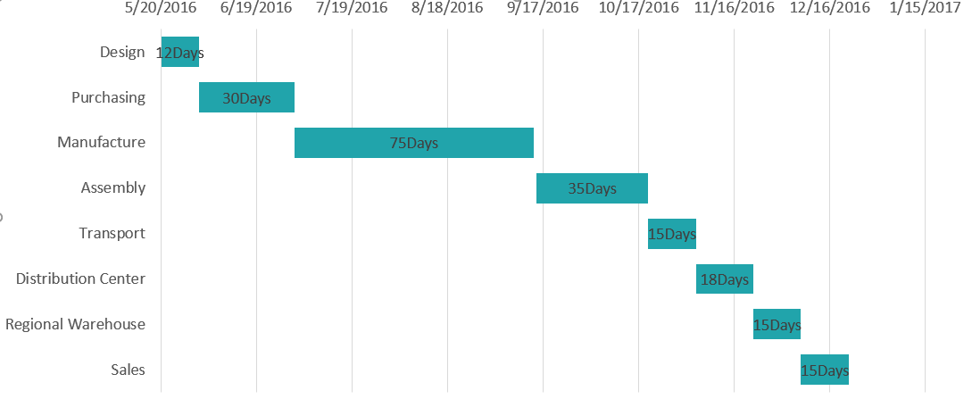
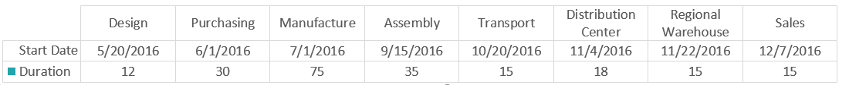
Launch Schedule

Slide 14
Project Risks
Labor Strike
Delay in procurement
Natural Calamity
Shipment Delays
Machinery Breakdown

Slide 15
Change Management Plan
Create change Control Document
Review impact and objectives of change
Create change approval board
Get appropriate approvals
Communicate Changes
Communicate the changes to the team members
Evaluate risks, changes to cost ,time and budget, reasons, source
Identify the stakeholders for change approval
Allocate resources to achieve the change after approval

Slide 16
Appendix

Slide 17

Questions?
Thank You

